Slide 1
The Index Poisoning Attack in P2P File Sharing Systems
Shumanski, Andrei
Trigonakis, Vasileios

Slide 2
Agenda
P2P File Sharing
Systems under Evaluation
Types of Attacks
Solution
Measurements & Results
Conclusions

Slide 3
P2P File Sharing
One of the most important applications in the Internet
Huge cost for the “copyright industry”
Sharing systems under attack

Slide 4
Terminology
Title is a specific song or video
A given title can have many different versions
Each version has one identifier (hash of the version)
Multiple copies of identical versions in the system
Advertisements about the copies
Keyword search is used

Slide 5
Agenda
P2P File Sharing
Systems under Evaluation
Types of Attacks
Solution
Measurements & Results
Conclusions

Slide 6
Systems under Evaluation
Overnet:
DHT-based file sharing system
used in eDonkey2000 and eMule
FastTrack:
two-tier unstructured file sharing system
used in Kazaa, Grokster and iMesh

Slide 7
Agenda
P2P File Sharing
Systems under Evaluation
Types of Attacks
Solution
Measurements & Results
Conclusions

Slide 8
Types of Attacks
Pollution attack: making available corrupted content
Resource intensive attack
Index poisoning attack: inserting massive numbers of bogus records into the index
Structured & unstructured systems
Requires less resources
Decoy attack: either pollution or poisoning

Slide 9
The Index Poisoning Attack
Typically, no authentication so it easy to advertise bogus information
Possible bogus information:
non-existing, random ids (mostly used)
non-existing IPs
unavailable service port numbers

Slide 10
FastTrack & Index Poisoning Attack
Decentralized & unstructured (two-tier)
Two classes of nodes:
Ordinary-Nodes (ONs)
Super-Nodes (SNs)
SN overlay, keeps the index
Attack by:
inserting bogus records into the indexes of the SNs
TCP connection to a SN → publish bogus id/IP/port

Slide 11
Overnet & Index Poisoning Attack
Based on Kademlia, all nodes equal
UDP messages
Two-step publishing:
Version ids
Keyword hashes
Attack by:
defining the target keywords and hash them
random id, not derived by some existing file, OR publish <key, value> and then <value, location>, where location is bogus
periodically refresh this information

Slide 12
Agenda
P2P File Sharing
Systems under Evaluation
Types of Attacks
Solution
Measurements & Results
Conclusions

Slide 13
Solution - Methodology
Downloading of files too expensive
Solution:
Harvesting: collect the version ids and publisher node data & create a list of the advertised versions and a list of the distinct copies of each version. Done by:
FastTrack: a crawler
Overnet: inserting a node in the DHT with the target keywords hash as id
Classify the versions (clean, polluted, poisoned)
Determine the pollution and poison levels for the versions and copies

Slide 14
Solution - Classifying the Users
Observation: “Among the users (with at least one version) the majority of users advertise a few versions (Light users) and a relatively small number of users advertise a large number of versions (Heavy users).”
U: set of users advertised at least one version of a title
V_{u}^{t}: for u ε U, the # of versions of title t from user u
: max # of versions for user u
: the mean across all users
K: constant so that: u is Heavy user ⇔

Slide 15
Solution - Classifying the Versions
Heuristic:
V → set of all the advertised versions
V_{H} → by heavy users
V_{L} → by light users
V_{X} = V_{H} ∩ V_{L} → polluted versions
V_{H}* = V_{H} – V_{X} → poisoned versions
V_{L}* = V_{L} – V_{X} → clean versions
A normal user would advertise a small number of versions.
V_{H}*
V_{L}*
V_{X}

Slide 16
Poisoning & Pollution Levels
poisoning:
|V_{H}*| / |V|
pollution:
|V_{X}| / |V|
clean:
|V_{L}*| / |V|
poisoning:
pollution:
clean:
C_{u} is the set of copies for version u
Version Levels
Copy Levels

Slide 17
Agenda
P2P File Sharing
Systems under Evaluation
Types of Attacks
Solution
Measurements & Results
Conclusions

Slide 18
Evaluation of the Heuristic
Only in FastTrack
Overall, the scheme correctly classified more than 96% of the
versions.

Slide 19
Measurements & Results
FastTrack (data set collected by the crawler in April 2005):
Decoyers are 7% of all users but provide 77% of all copies and 73% of all versions
 | # of IPs | # of users | # of copies | # of versions
Decoyer | 624 | 8,683 | 1,183,622 | 443,102
Ordinary | 82,015 | 117,673 | 347,939 | 167,103
Overnet (data set collected by the inserted nodes in June 2005):
Decoyers are 0,2% of all users but provide 58% of all copies and 85% of all versions
 | # of IPs | # of users | # of copies | # of versions
Decoyer | 26 | 27 | 23,771 | 22,678
Ordinary | 12,135 | 12,545 | 17,104 | 3,907

Slide 20
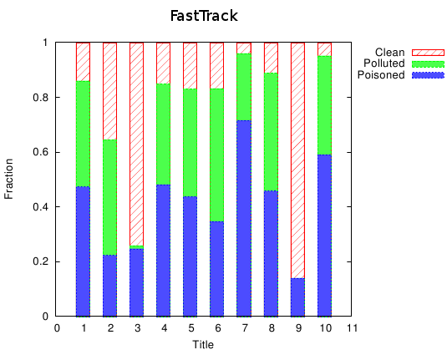
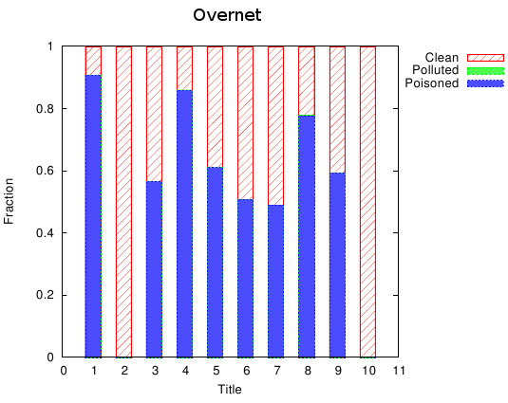
Mesurements & Results - Copies
There are different companies and techniques
Total decoy percentage is up to 95%
Little pollution in Overnet

Slide 21
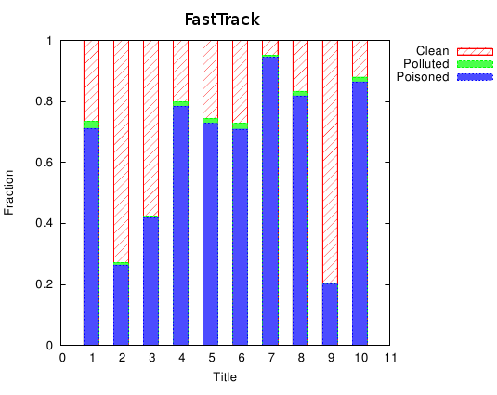
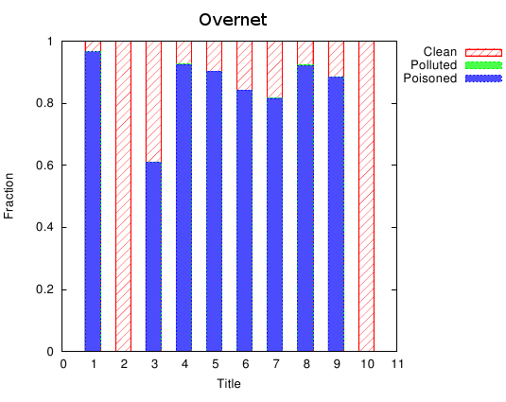
Mesurements & Results - Versions
Majority of versions are poisoned
Poisoning level up to 90%
Differences in poison and pollution levels between versions and copies:
copies of the poisoned versions do not circulate
decoyers make many copies of the same polluted version

Slide 22
DHT Vulnerabilities to Poisoning
Node insertion attack:
Not observed in FastTrack
Observed in Overnet – decoyers’ nodes return random identifiers, prevent users from finding clean versions
Poisoning: DHT vs. Unstructured
Small # of titles → DHT requires less resources
Increasing # of titles → eventually, DHT requires more resources
DDoS attack by exploiting DHT
pointing one node

Slide 23
Defending against Poisoning Attack
Rating versions and advertisements - forums
Rating sources:
Reputation for range of IPs
Reputation based on number of copies per title
Nodes exchange reputation lists

Slide 24
Agenda
P2P File Sharing
Systems under Evaluation
Types of Attacks
Solution
Measurements & Results
Conclusions

Slide 25
Conclusions
Both structured & unstructured overlays are vulnerable
Heuristic to detect the polluted and poisoned versions/copies with a good approximation
Defend by rating versions & sources
DDoS attack possible in a DHT

Slide 26
References
J. Liang, N. Naoumov, KW. Ross, The index poisoning attack in p2p file sharing systems, IEEE INFOCOM, 2006.

Slide 27
The end..
Thank you ☺

